Slide 1
SUMMER PROJECT | AI-BASED THREAT DETECTION
Submitted by: Gowthami K (2022115026)
Gabriella D (2022115055)
Project Guide: Dr K Indra Gandhi

Slide 2
Introduction
In today's digital landscape, security vulnerabilities pose significant risks to organizations and their data. As cyber threats evolve, it becomes crucial to implement advanced detection systems that can identify and mitigate these vulnerabilities effectively. This project focuses on developing an AI-based threat detection system specifically designed to scan for two of the most critical vulnerabilities listed in the OWASP Top 10: SQL Injection (SQLi) and Broken Access Control (BAC).
SQL Injection: A technique used by attackers to manipulate SQL queries, allowing unauthorized access to sensitive data. It is one of the most common and damaging vulnerabilities in web applications.
Broken Access Control: Refers to flaws in enforcing proper restrictions on authenticated users. This vulnerability can lead to unauthorized actions, such as viewing or modifying sensitive data

Slide 3
Problem Definition
Background:
As cyber threats continue to grow in complexity, organizations face increased challenges in securing their applications against vulnerabilities such as SQL Injection and Broken Access Control. Despite the existence of various security tools, these vulnerabilities remain prevalent, highlighting gaps in current solutions.
Current Challenges:
Inadequate Detection Accuracy:
Many existing solutions struggle with high false positive and false negative rates, leading to either alarm fatigue or missed vulnerabilities. Traditional signature-based detection methods often fail to recognize new or evolving attack patterns.

Slide 4
Problem Definition
Limited Scope of Detection: ​
Most tools focus on only one type of vulnerability (e.g., SQLi) or provide limited analysis for access control issues.​ There is a lack of comprehensive solutions that address both SQLi and BAC vulnerabilities simultaneously.​
Lack of Real-Time Analysis:​ ​ Current tools may not provide real-time scanning capabilities, making it difficult for organizations to respond promptly to emerging threats.​ Delays in detection can lead to significant data breaches and financial losses.​
Insufficient Mitigation Guidance:​ ​ Many existing solutions identify vulnerabilities but do not offer actionable recommendations for remediation.​ Organizations often lack the expertise to interpret vulnerability reports and implement effective security measures

Slide 5
Objective
Develop a Comprehensive Scanning Tool:
Create an AI-driven system that scans applications for SQLi and BAC vulnerabilities.
Utilize Machine Learning Techniques:
Leverage machine learning algorithms to enhance detection capabilities and reduce false positives.
Provide Mitigation Strategies: ​
​
Offer actionable insights and recommendations to address identified vulnerabilities​

Slide 6
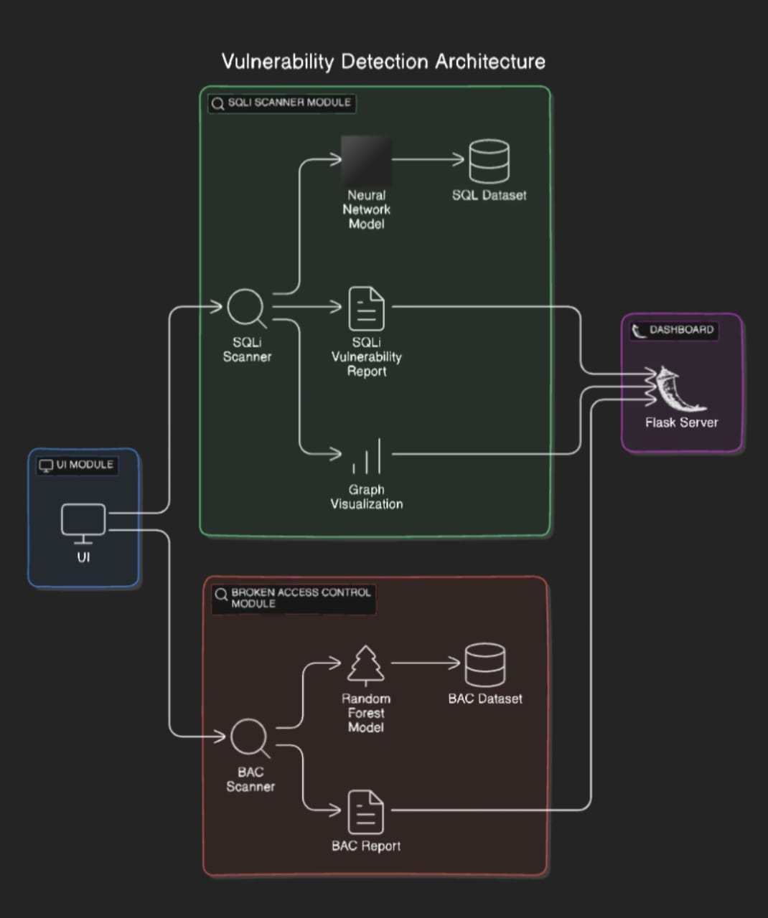
System Architecture

Slide 7
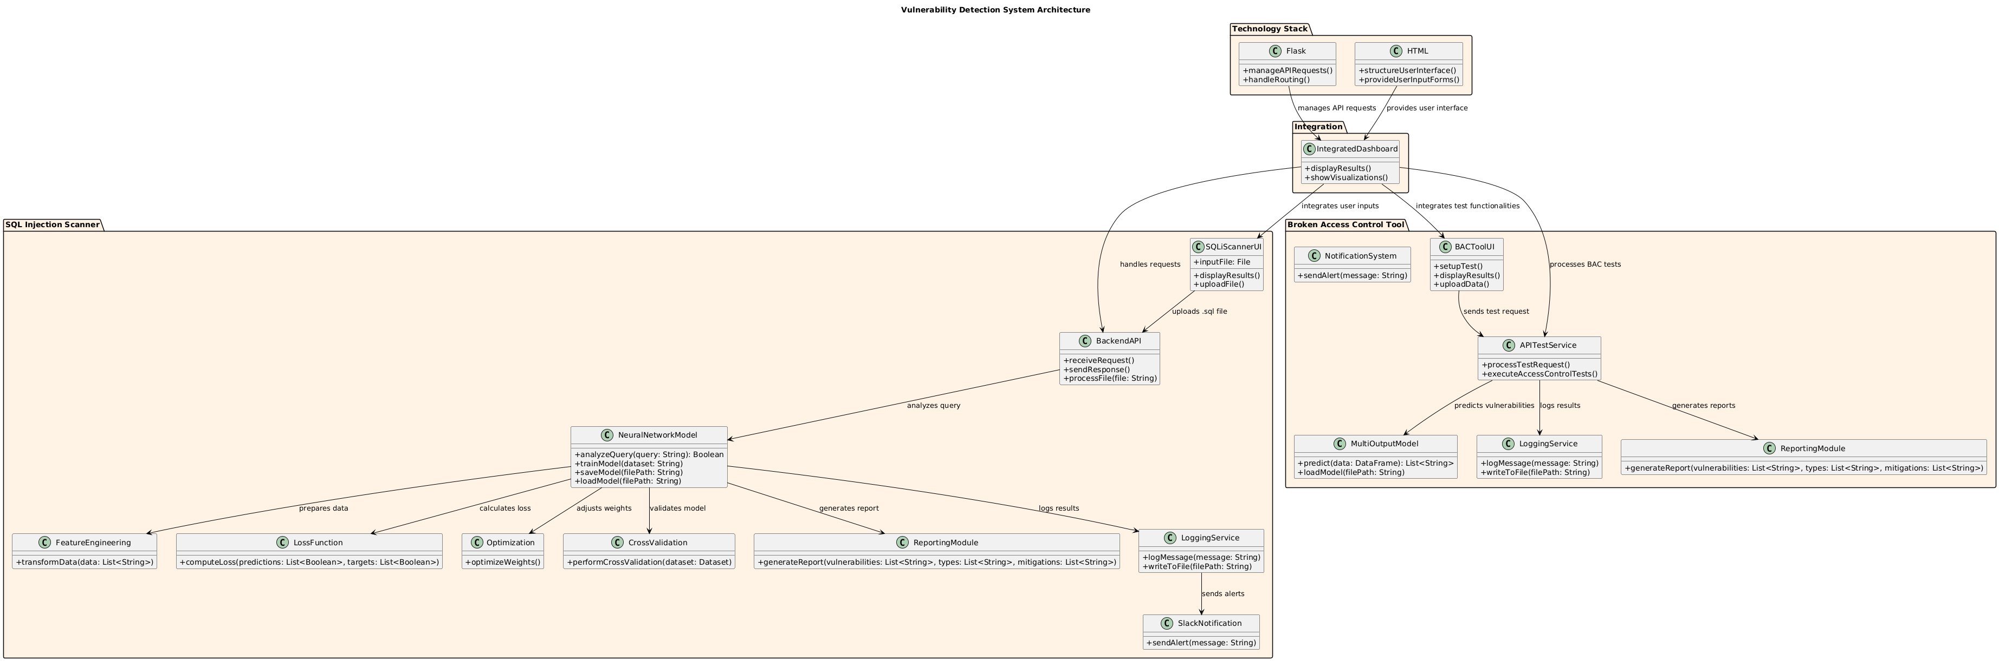
Detailed Design

Slide 8
Tools and Technologies used
Dash: Framework for building interactive web applications in Python, enabling real-time visualization of BAC detection results.
Plotly Express: Library for creating interactive charts and graphs to visualize vulnerability data effectively.
Scikit-learn: Machine learning library for model training, preprocessing, feature extraction, and evaluation of both BAC and SQL Injection detection models.
Joblib: Tool for saving and loading machine learning models and preprocessing steps efficiently.
Pandas: Data manipulation library for handling data loading, preprocessing, and analysis across BAC detection and SQL Injection models.
NumPy: Library for numerical operations, supporting mathematical computations in model training and predictions.
Matplotlib: Visualization library for creating charts and graphs that summarize scan results and vulnerability distributions.
Keras: High-level neural networks API for building and training SQL Injection vulnerability detection models.

Slide 9
Tools and Technologies used
OneHotEncoder: Transforms categorical features into a binary format for machine learning models.
StandardScaler: Normalizes numerical features, improving model performance and convergence.
MultiOutputClassifier: Enables multi-target prediction by wrapping a single classifier to handle multiple outputs in BAC detection.
Pipeline: Integrates preprocessing and model training into a single object, reducing data leakage and ensuring consistency.
gc: Python’s garbage collector, used for memory management during model training.
Flask: Web framework for managing backend routes and serving the SQL Injection scanner and dashboard applications.
Flask-CORS: Middleware that allows secure Cross-Origin Resource Sharing between the Dash app and external services.
HTML/CSS: Core web technologies used for structuring and styling user interfaces, including file uploads and display of results.

Slide 10
Tools and Technologies used
Bootstrap: Front-end framework for responsive and visually appealing user interfaces with pre-built components.
JavaScript and Fetch API: Enables dynamic behaviors on web pages, like asynchronous HTTP requests and real-time updates of system metrics.
psutil: Library for system utilities, providing metrics such as CPU and memory usage for monitoring.
JSON: Data format for exchanging information between the backend and front end, especially for system metrics and scan results.
Responsive Design: Ensures accessibility across devices by adapting the dashboard to different screen sizes.
Requests: Library for HTTP requests, used for integrating Slack alerts on detected vulnerabilities.

Slide 11
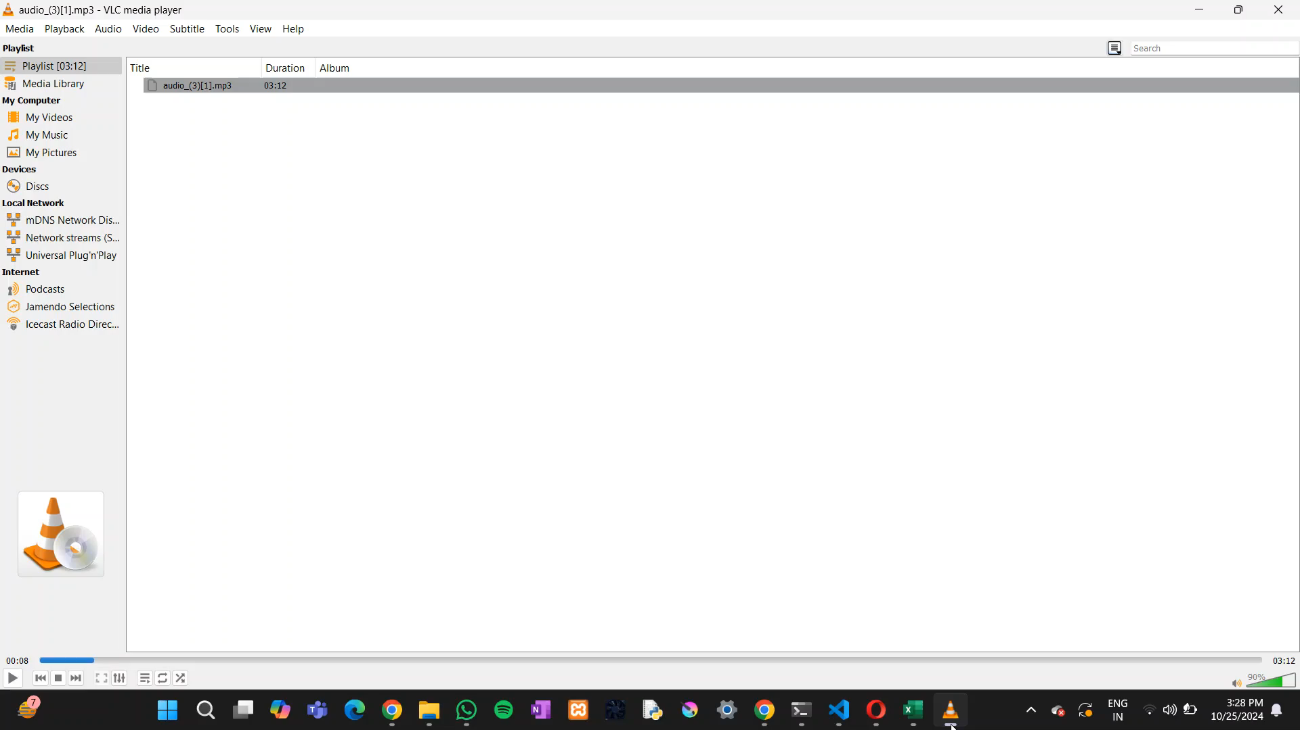
Output

Slide 12
Results and Discussion
Broken Access Control (BAC) Detection:
Detection and Classification
Overview: Detects vulnerabilities in access control, categorizing them by type (e.g., Vertical Access Control, Horizontal Access Control).
Severity and Priority Levels: Assigns a severity score and priority ranking for each vulnerability, aiding in efficient risk assessment.
Graphical Insights
Bar Charts: Show frequency of each vulnerability type, helping to prioritize common vulnerabilities.
Pie Charts: Visualize distribution of vulnerabilities by severity, offering an at-a-glance view of system risk.
Timeline Analysis: Tracks vulnerability occurrence over time, identifying trends and peak times for vulnerabilities.

Slide 13
Results and Discussion
Heatmaps and Histograms:
Heatmaps: Indicate high-risk areas or time periods with clustered vulnerabilities.
Histograms: Display distribution of severity scores, allowing for a detailed risk profile.
Detailed Insights and Recommendations:
Potential Causes: Highlights common causes for each type of BAC vulnerability.
Mitigation Strategies: Provides targeted recommendations to address vulnerabilities effectively.
Response Timing: Suggests which vulnerabilities require immediate action, enabling faster resolution for critical issues.
Actionable Insights:
Priority and Urgency: Identifies high-risk injection types, helping prioritize immediate responses.
CSV Report: Exports detailed mitigation strategies and scan results for further analysis and record-keeping.

Slide 14
Results and Discussion
SQL Injection (SQLi) Scanner
Injection Detection and Classification
Injection Types: Identifies different SQL injection types (e.g., Error-based, Blind, Union-based), offering a nuanced view of potential threats.
Detection Metrics: Measures detection accuracy, highlighting the scanner's effectiveness.
Graphical Reporting
Bar Chart of SQL Injection Types: Visualizes the frequency of each SQL injection type, aiding in targeted prevention measures.
Causes and Mitigation:
Potential Causes: Lists common factors contributing to SQL injection vulnerabilities, fostering preventive planning.
Mitigation Strategies: Suggests strategies tailored to each SQL injection type for effective remediation.

Slide 15
Results and Discussion
Actionable Insights:
Priority and Urgency: Identifies high-risk injection types, helping prioritize immediate responses.
CSV Report: Exports detailed mitigation strategies and scan results for further analysis and record-keeping.

Slide 16
References
SQLi Detection:
Deep Learning-Based Detection Technology for SQL Injection. MDPI, 2021​
Detection of SQL Injection Attack Using Machine Learning Techniques: A Systematic Literature Review. MDPI, 2022​
Analysis of AI-based SQL Injection Detection Models. ResearchGate, 2022​.
Broken Access Control Detection:
Barabanov, A., et al. “Automatic Detection of Access Control Vulnerabilities via API Specification Processing.” arXiv, 2022​
Alohaly, M., et al. “Machine Learning in Access Control: A Taxonomy and Survey.” arXiv, 2022​
Various Authors. “Toward Deep Learning Based Access Control.” arXiv, 2023​

